Slide 1


Expanded Mobile Response & Stabilization Services Peer Meeting:
DAY 2
MAY 23-24, 2018
PISCATAWAY,NJ
Substance Abuse and Mental Health Services Administration
U.S. Department of Health and Human Services

Slide 2
This peer small group meeting is hosted by the National Technical Assistance Network for Children’s Behavioral Health (TA Network), operated by and coordinated through the University of Maryland
This presentation was prepared by the National Technical Assistance Network for Children’s Behavioral Health under contract with the U.S. Department of Health and Human Services, Substance Abuse and Mental Health Services Administration, Contract #HHSS280201500007C. The views, opinions, and content expressed in this presentation do not necessarily reflect the views, opinions, or policies of the Center for Mental Health Services (CMHS), the Substance Abuse and Mental Health Services Administration (SAMHSA), or the U.S. Department of Health and Human Services (HHS).

Slide 3
Day 2 Agenda: First Time Participant Teams
Adapting Clinical Best Practices and Strategies and What’s Next in the Evolution of MRSS
Facilitated Individual Team Meetings
Lunch (on your own)
Facilitated Individual Team Meetings
Joint Wrap Up and Next Steps
MRSS Resource Material Library: http://www.tanetworkmeetings.org/2018-mrss-resources

Slide 4
Day 2 Agenda: Alumni Track
 | Cohort 1 | Cohort 2 | Cohort 3 | Cohort 4
8:00-9:30AM | Quality/IT (Library) | Service Array (Boardroom B) | Finance & Policy (Salon E) | Supervision, Training, Staffing (Boardroom C)
9:30-11:00AM | Service Array (Boardroom B) | Finance & Policy (Salon E) | Supervision, Training, Staffing (Boardroom C) | Quality/IT (Library)
11:00-11:15AM | Break
11:15-12:45AM | Finance & Policy (Salon E) | Supervision, Training, Staffing (Boardroom C) | Quality/IT (Library) | Service Array (Boardroom B)
12:45-1:30PM | Lunch (on your own)
1:30-3:00PM | Supervision, Training, Staffing (Boardroom C) | Quality/IT (Library) | Service Array (Boardroom B) | Finance & Policy (Salon E)
3:00-3:30PM | Joint Wrap Up & Next Steps

Slide 5
Alumni Track Meeting Rooms
Team | Faculty | Room
Finance & Policy | Dayana | Salon
Quality & IT | Jeff | Library
Service Array | Liz | Boardroom B
Supervision, Training & Staffing | Chris | Boardroom C

Slide 6
Connecticut’s Mobile Crisis Intervention Clinical Best Practices
Tim Marshall, L.C.S.W.
Clinical Manager
CT Department of Children and Families

Slide 7
Best Practice Components
  Crisis defined by caller
  Clearly defined goals and outcomes
  Robust staffing
  Ongoing outreach and education activities
  Good working relationships with: Emergency departments, schools, foster care, law enforcement and other key stakeholders
  Core intervention skills
  Annual workforce development and standardized training activities
  Routine reporting, data analysis and ongoing quality improvement
    Annual quality improvement plan

Slide 8
Accessing Mobile Crisis
Why provide a mobile response vs. telephone?
  Crisis situation and mobile response might be first system introduction
  Making a face-to-face connection, assessing strengths and needs in person
  Addresses access barriers that impact disadvantaged populations
  Mobile response facilitates being a resource not just to the family, but to the community

Slide 9
Staffing
170+ full and part time/per diem clinicians statewide
Most Mobile Crisis teams housed within large community-based mental health clinics with full service array
Clinicians are typically master level (MSW, LPC, or LMFT), licensed (or license-eligible) clinicians
.5 to 1.0 FTE directors at each site (MA or doctoral level)
Each contract includes capacity for psychiatric consultation and medication management
Family partners used on some teams, primarily for parent engagement and follow-up
Team responses are preferred, but less likely to occur as volume has increased over time

Slide 10
Goals
  Child and Family:
  Stabilize the presenting crisis
  Promote/enhance emotional and behavioral functioning
  Link to existing provider or facilitate linkage and transfer to appropriate services and supports
  Empower children and families to monitor, manage and cope with situations that may lead to further crises
  Provider:
  Deliver behavioral health crisis-oriented services that are highly mobile and responsive to child and family needs
  Provide appropriate screening, early identification and assessment of suicide risk, trauma exposure, substance use, exposure to and risk of violence, eating disorders and other clinical presentations
  Include family members and informal supports in all aspects of the planning and treatment process, whenever possible

Slide 11
Goals (cont.)
  System:
  Ensure that all children and their families have access to crisis, prevention, and intervention services and supports
  Whenever possible, maintain youth in their homes and communities and prevent placement in restrictive care settings such as emergency departments, inpatient hospitalization and arrest/incarceration
  Increase community awareness of behavioral health needs by providing prevention and treatment-oriented education and outreach to families, schools and communities

Slide 12
Available Services
Mobile response to homes, schools, EDs, community locations
Crisis stabilization
Diversion from the ED, collaboration with ED, inpatient hospitals, law enforcement intervention, schools
Clinical assessment using standardized instruments
Follow-up services for up to 45 days (and unlimited episodes of care)
Access to psychiatric evaluation and medication management
Collaboration with families, schools, hospitals, other providers
Referral and linkage to ongoing care as needed

Slide 13
Practice Model: Assessment (Phase One)
Responding to the first call of a new episode of care
  Screen out inappropriate calls (i.e., transfer to 911, 211 Information Only)
  Warm transfer to Mobile Response
  211 clinician response after mobile hours (follow up next mobile hours)
First Mobile Response
  Non-mobile initial response (upon family request)
  Deferred mobile initial response (upon family request)
  Mobile Response
Acuity levels
  High (face to face every 1-2 days)
  Intermediate (face to face every 2-3 days)
  Low (face to face 1 time a week)
  Balance need for follow-up with new referrals

Slide 14
Practice Model: Assessment (Phase One) cont.
  Standardized Assessment Measures
    Uniform crisis intake assessment
    Acuity assessment
    Emergency Certificate
    SAVRY
    UCLA-PTSD-RI or Child Trauma Screen (CTS)
    GAIN-SS
    Eating Disorders Inventory
    SBIRT (CRAFFT, S2BI)
    Ohio Scales

Slide 15
Practice Model: Crisis Stabilization and Transition (Phase Two)
  Initial and ongoing crisis stabilization
  Review results of assessment measures
  Develop a Care Plan
  Address factors contributing to or maintaining the crisis
  Address trauma exposure and symptoms of traumatic stress
  Develop and review reactive and proactive crisis plans
  Ongoing acuity/risk assessment
  Refer for psychiatric evaluation as indicated
  Provide coordination of care
  Enhance motivation to participate in ongoing care
  Communicate with original referrer (as needed)
  Facilitate transition to ongoing services and supports

Slide 16
Standardized Training
Core Modules – 1 (4x/year)
Crisis Assessment, Planning and Intervention
Traumatic Stress and Trauma Informed Care
Emergency Certificate Training
Assessing Violence Risk in Children and Adolescents
Core Modules – 2 (3x/year)
21st Century Culturally Responsive Mental Health Care
Disaster Behavioral Health Response Network (DBHRN)
An Overview of Intellectual Disabilities and Positive Behavioral Supports
Question, Persuade and Refer (QPR) (in-house training)
Strengths-Based Crisis Planning
Columbia Suicide Severity Rating Scale (C-SSRS) (Online training)
Adolescent Screening, Brief Intervention and Referral to Treatment (A-SBIRT)(in-house training)
Autism Spectrum Disorder (added in FY2018)
Parents are paid co-trainers and members of agency Quality Improvement teams
Parents are also welcomed to take part in the in-house trainings
Notes:
Core Module-1 delivered 4X/year, in different regions of the state
Core Module-2 delivered 3x/year
In house training are

Slide 17
Outreach Activities
Minimum 24 formal outreach activities per year for all providers
    Priority will be given to schools, law enforcement, foster care providers and identified high volume referrers to local Emergency Departments.
52 outreach activities for those below the per 1000 service reach benchmark

Slide 18
Annual Quality Improvement Plan (QIP)
Contractor will identify:
  Areas of strength supported by data, i.e. areas of practice that the Contractor believes are being accomplished in the most beneficial way possible. In addition, the Plan will include a description of the internal practice the EMPS provider uses to achieve these successes. This information will be shared with DCF and when combined with that of other contractors, will form a "best practice" document;
  A minimum of two areas of practice in which improvement seems needed. These areas should also be supported by data, and should be consistent with what the Department has identified as priority practice issues. The Plan should articulate strategies that the Contractor believes will have a positive effect on the identified areas; and
  A Data Quality Monitoring process that ensures that data entry is efficient, effective and minimizes the possibility of data errors. The process will include the review of critical data at least weekly if not daily.

Slide 19
Milwaukee’s MRSS System
Lessons Learned, Best Practices and New Directions
Bruce Kamradt MSW,
Administrator Emeritus, Wraparound Milwaukee
Chad Meinholdt LCSW,
Director of Community Centers, Milwaukee County Behavioral Health Division

Slide 20

Lessons Learned From A System Of Care Perspective
Mobile Crisis:
  First component of our system of care developed because of need to reduce inpatient hospital and other institutional care
  Allowed redirection of saved monies (“Gatekeeper Function”)
Advantageous to integrate Mobile Crisis with the Wraparound Milwaukee system of care because it works so closely with the care coordinators and child & family team in developing and supporting crisis/safety plans
Challenging to integrate the Children's Mobile Crisis team with the county’s adult crisis programs due to different goals, philosophy and operations.
  That is changing with some new leadership in Adult Crisis

Slide 21
Lessons Learned from System of Care Perspective (cont.)
Must have an array of crisis stabilization services (i.e. in-home stabilizers, crisis beds, etc.) to support crisis plans and alternatives to out of home care
Need good relationships with inpatient psychiatric facilities including Memoranda of Understanding (MOU) to avoid arguments over medical necessity
CMC has probably the highest visibility of any piece of the SOC - high name recognition
Been critical to partner with child welfare, juvenile justice, courts, schools, police and advocacy groups to get buy-in and support and to expand new service models.
Need to integrate mobile crisis team notes and plans with care coordinator notes, plans of care in one electronic health record

Slide 22
Hiring Staff: What we say we want v. What we really want
“Works with diverse populations”
“Available flexible hours”
“Explains ideas clearly”
Knowledge of community resources
Knows emergency laws
“Effective interpersonal relationships…”
Knows steps of de-escalation
Calm in a crisis
Non-judgmental
Persistent – won’t give up
Hopeful
Strengths and solutions
Big picture
Outside of “self”
Tolerant
Exudes hope

Slide 23
Staff Needs
Resilience, perspective, and persistence
“What’s in it for me?”
  Hint: You’d better notice the small rewards…
Using staff meetings, ritual and relying on each other
Take care of yourself first

Slide 24
Crisis Work is Especially Hard on Staff
Leadership really needs to ensure staff are healthy, balanced and get along. This puts them in a much more favorable place to help others.

Slide 25
What Is Crisis Intervention?
A lifeline
Emotional CPR
Psychological First Aid (PFA)
A strategy and service on the continuum of help

Slide 26
And When Responding, There’s Theory (Looks easy doesn’t it?)…
Contact, establish relationships
Define problem - assess dangerousness
Explore past coping strategies
Generate alternatives
Develop and implement action plan
Follow up

Slide 27
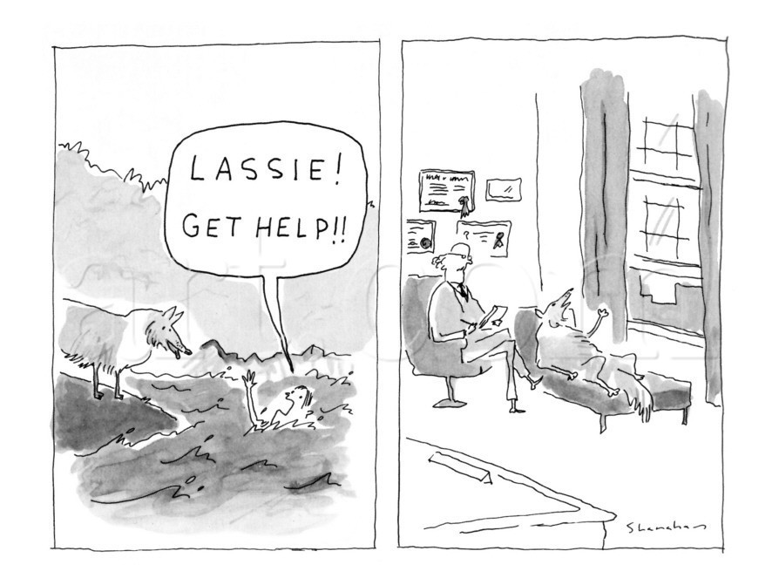

Slide 28
The X-factor in Crisis Intervention
Engagement!
The FBI’s secret to hostage situations, and more = empathy and banter

Slide 29
Hospitalization:
Statutes and Medical Necessity Protocols Often Focus on Wrong Thing:
They all ask the wrong questions
Almost invariably there are simply set “standards” for admission/detention
The key question is not about dangerousness, it’s knowing the risks:
  “what would it take to keep this child safe in the community tonight/tomorrow?”

Slide 30

Because It’s About Needs and Safety Planning NOT “Meeting Criteria”
Don’t make it about whether someone does or doesn’t “meet criteria”
  Puts focus, and the question on how spectacular, serious, significant the recent or past behavior was
  Encourages escalation to convince that youth has “done enough” to justify hospital
Do make it about safety and needs:
  This discussion acknowledges risk behavior, but centers on reducing risk through strategies and a plan
  Can we keep this person, and others, safe, with this plan?
  Critical question is “what would it take to safely get this person through the next hours, day?”

Slide 31
New Directions in Expanding Child Mobile Crisis (CMC)
TRAUMA RESPONSE TEAM(TRT)
  Milwaukee Police Dept. and Wraparound Milwaukee CMC team joint venture to respond to children in the community that have been exposed to community or domestic violence or stressful experiences
  Emphasis is on training parents, caregivers as first responders in trauma, to lower risk of PTSD
  Funded by City of Milwaukee-$200,000

Slide 32
Crisis Assessment and Response Team (CART)
Partnership between law enforcement and crisis services
  Started with adult team and planned expansion to youth
Co-responder program comprised of clinician and officer dyad responding to calls where police intervention may be needed
Officers receive Crisis Intervention Training (CIT) and one month of additional crisis training with Milwaukee Crisis Services
Funded through Milwaukee County and police departments
Goal to reduce involuntary detentions, stigma, use of force, increase service linkage
90% of people served in 2017 stabilized in the community or voluntarily received treatment
  Over 1200 calls and 600 face to face assessments 1/1/2017 – 12/31/2017

Slide 33
Coordinated Opportunities for Recovery and Empowerment (CORE)
CORE team supports youth/young adults who have experienced their first episode of psychosis
Part of CMC team
Five-person team blending care coordination, therapy, supported employment/educational support, peer support, and medication management
Serves youth/young adults 12-24
Strength-based, individualized service planning

Slide 34
Proactive Outreach for Sexually Exploited Youth (POSEY)
1 in 12 adolescents seen by CMC have been victim of sexual exploitation
33% of all trafficking victims are children
Average age for entry for boys is 11-13, for girls it’s 12-14
Mental health issues: PTSD, aggression, suicide, trauma
POSEY develops appropriate screening tools to identify victims, specialized crisis mentoring, drop-in center operated by Wraparound Milwaukee
Health care clinic co-located with CMC

Slide 35
Youth Living Out Loud Mentoring Program
Mentoring program focused on serving sexually exploited children
Specialized training in the topics of sexual exploitation, medical and legal protocols, trauma informed care, and warning signs
Mentor Action Plan developed to support the goal of the youth and ensure their voice is heard
Partnership with community crisis stabilization agency, medical college, Rethink Resources (training and consultation), and LGBTQ resource
Initial funding provided by Office of Juvenile Justice and Delinquency Prevention

Slide 36
Expanded Use of Peer Support
Increased utilization of Certified Peer Specialists on crisis teams
  Engage youth in their care and recovery
Parent Peer Specialist Model
Young Adult Peer Specialists share lived experience and mentor youth
Learn from adult models:
  Community Linkages and Stabilization Program (CLASP)-community based program for adults
  Peer Run Respite Initiative
  Peers in stabilization house, crisis resource centers, and inpatient units
Peer support is a Medicaid reimbursed service and part of the system of care

Slide 37

Discharge Follow-Up Team (Team Connect)
Team comprised of clinician and Certified Peer Specialist
  started in adult crisis services and expanding to youth team
Follow up with people at discharge from ER, inpatient units, and observation unit
  follow up 24 hours via phone following discharge
Includes:
  Zero Suicide* initiative screening (PSQ-9 and Columbia)
  mobile crisis response
  linkage to service
  services based on individual needs
Goals are to:
  reduce recidivism and self harm,
  increase post discharge follow up care
Expanded to 4 teams based on utilization and needs of the people being served
* https://zerosuicide.sprc.org/

Slide 38
Future Direction
Integration of all crisis services - adult and youth teams
  one integrated team to increase efficiencies
  clinicians with additional, specialized training in working with specific populations (adults, youth, IDD, geriatric, substance use, law enforcement)
Set expectations across team for quality, productivity, training, supervision, etc.
Increase revenue and staff productivity (areas of overlap)
Integrate best practices into one team
Explore new service areas and expanding use of peer support
Focus on serving and collaborating

Slide 39
Apps and Social Media: For Better or Worse…
Teens are more likely to turn to social media, texting for support than to call a help or hotline
Phones, texts set off powerfully addictive responses in the brain
Texting is private and many kids find it easier to disclose
They look like they’re just doing something normal – important to teens
E.g., National Dating Abuse Hotline; National Human Sex Trafficking Center – both accessible by text = used often!

Slide 40
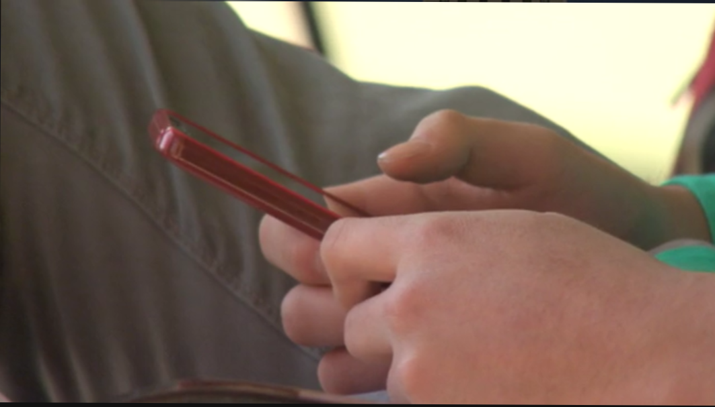
CTL: The Crisis Text Line
http://www.nbcnews.com/nightly-news/video/new-crisis-hotline-approach-is-changing-the-way-we-deal-with-stress-700646467944

Slide 41
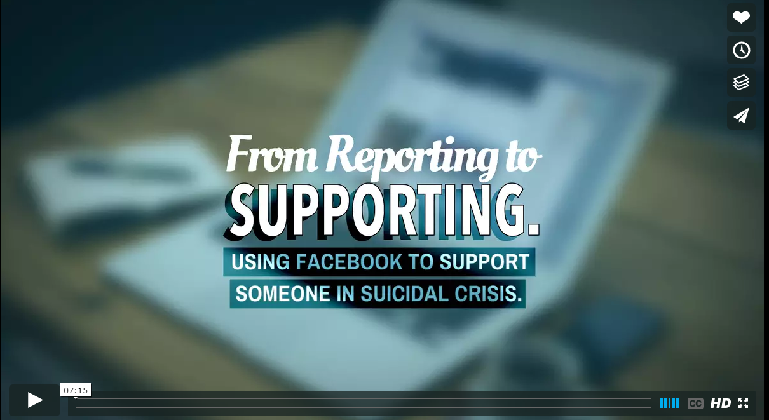
Social Media and Suicide Prevention:
Help from Facebook
https://vimeo.com/160565004

Slide 42

The Evolution of MRSS: What Is Next for NJ
Wyndee Davis
Assistant Director
NJ Children’s System of Care

Slide 43
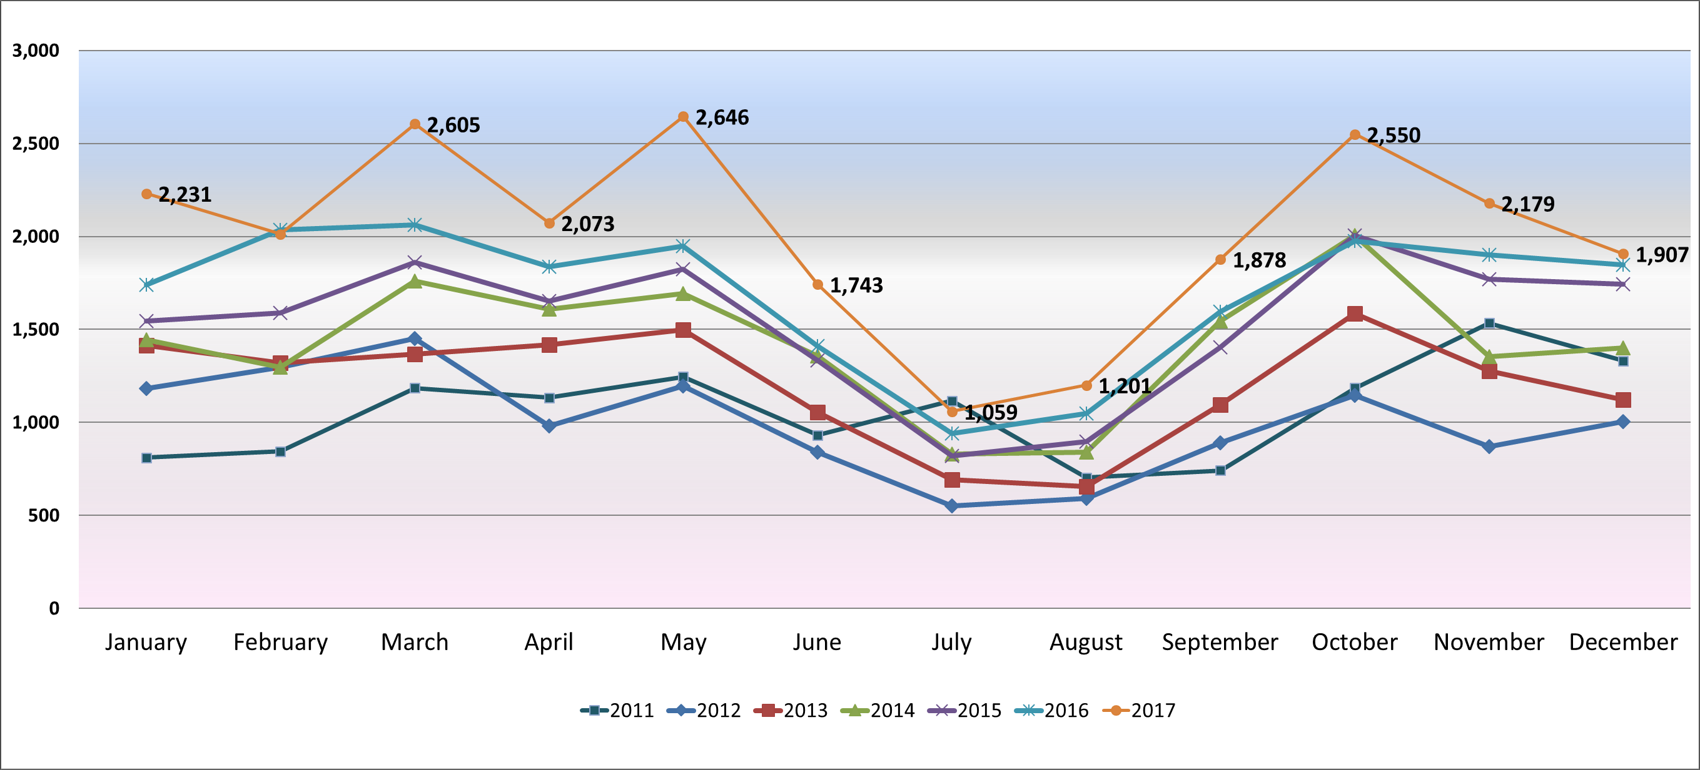
MRSS Dispatch Data

Slide 44
NJ’s Mobile Response and Stabilization Services

Slide 45
NJ Populations
Integrating Care for Individuals With:
Intellectual /Developmental Disabilities
Substance Use Disorders

Slide 46
NJ’s Trauma Informed Care
Promising Path to Success - NJ’s SOC Expansion Grant
Six Core Strategies©
Nurtured Heart Approach®
Youth Partnerships
Return on Investment

Slide 47
NJ’s Trauma Informed Care: Youth in Foster Care
NJ CSOC quality drill down of data for youth in foster care who required out of home treatment due to behavioral challenges experienced in care
We recognized that MRSS was not utilized as designed with our child welfare partners
  We shared the data with DCF leadership
  Engaged in discussion regarding barriers
  Provided training and support to our partners
  Developed and implemented a pilot to address the issue
  Reviewed the results of the pilot and now are implementing strategies statewide
CSOC continues to monitor the impact of this practice change

Slide 48
NJ’s Trauma Informed Care
Strengthening Supports for Youth Involved With Child Welfare
  MRSS/Child Welfare Project
  Functional Family Therapy -Foster Care (FFT-FC)
ARC Grow
Ensuring MRSS connection to acute care is supportive to families, systemically and on an individualized basis

Slide 49
Facilitated Team Meetings
Session One (10:30a-12:00p):
  Review your identified objectives
  Work with assigned faculty who will offer facilitation, support and targeted technical assistance related to your objectives
Session Two (1:15-3:00p):
  Work in your team with assigned faculty to identify:
    Actionable goals and strategies to implement when you return home
    Immediate and longer term TA needs

Slide 50
Faculty Team Meeting Assignments
Team | Faculty | Room
Fairfax County | Wyndee and Stacy | Boardroom A
Hennepin County | Bruce and Chad | Miracle Room
Ohio | Tim | Miracle Room
San Francisco | Ruby and Shannon | Miracle Room

Slide 51
Wrap Up and Next Steps

